Slide 1
Object Relational Mapping
SPECIAL JAVA SUBJECT FSOFT – Developer – Part3
HIBERNATE

Slide 2
Agenda
ORM
Hibernate Overview
Hibernate Association & Collection mapping
Hibernate Configuration
Hibernate Query Language (HQL)
Criteria Queries
Native SQL
Transaction
Build a Hibernate Application
Notes:
Overview: What is hibernate & high level architecture

Slide 3
What is ORM
ORM stands for Object-Relational Mapping (ORM) is a programming technique for converting data between relational databases and object oriented programming languages such as Java, C# etc.
Java ORM Frameworks:
Hibernate
Spring DAO
Open JPA
Mybatis
Toplink
Notes:
Object - Relational mapping: Map object-oriented domain model to relational database
Persistence of associations and collections
Hibernate, open source ORM framework, widely used
Open JPA, Apache, open source, supports JPA API
Mybatis, free open source, formerly named iBATIS
Toplink by Oracle

Slide 4
ORM Advantages
Lets business code access objects rather than DB tables.
Hides details of SQL queries from OO logic.
Based on JDBC
No need to deal with the database implementation.
Entities based on business concepts rather than database structure.
Transaction management and automatic key generation.
Fast development of application.

Slide 5
Hibernate is an Object-Relational Mapping(ORM) solution for JAVA and it raised as an open source persistent framework created by Gavin King in 2001. It is a powerful, high performance Object-Relational Persistence and Query service for any Java Application.
Hibernate maps Java classes to database tables and from Java data types to SQL data types and relieve the developer from 95% of common data persistence related programming tasks.

Slide 6
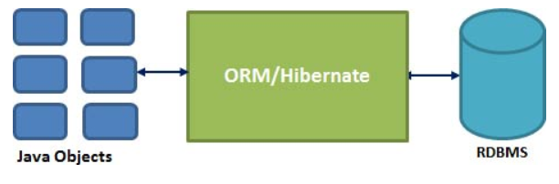
What is Hibernate
Hibernate is an Object-Relational mapping framework for object persistence
Notes:
Object - Relational mapping: Map object-oriented domain model to relational database
Persistence of associations and collections

Slide 7
Hibernate advantages
Mapping Java class to table
Support for Query Language
Abstract away the unfamiliar SQL types and provide us to work around familiar Java Objects
Database dependent Code, support multi databases: MySQL, MS SQL Server, Oracle…
Optimize performance
Automatic Versioning and Time Stamping
Notes:
Mapping: Do not need to write code for mapping
Optimize Performance: Relational tuples are moved to this cache as a result of query. It improves performance if client application reads same data many times for same write.
Optimistic locking: Assured that the changes done by one person is not being roll
backed by another one unintentionally

Slide 8
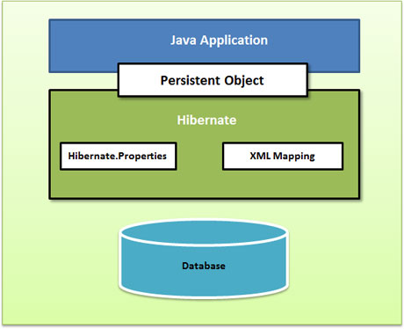
High Level Architecture
Notes:
Persistent objects are the classes that in your program that has a representation in the database

Slide 9
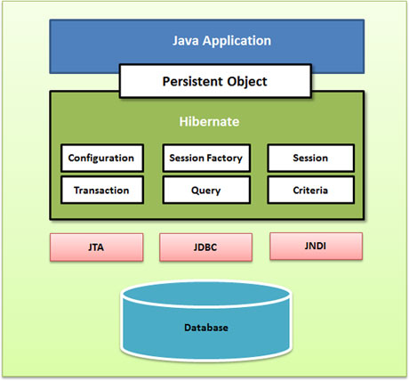
Detailed view of the Hibernate Architecture

Slide 10
Configuration Object
The Configuration object is the first Hibernate object you create in any Hibernate application and usually created only once during application initialization. It represents a configuration or properties file required by the Hibernate. The Configuration object provides two keys components:
Database Connection: This is handled through one or more configuration files supported by Hibernate. These files are hibernate.properties and hibernate.cfg.xml.
Class Mapping Setup

Slide 11
SessionFactory Object
Configuration object is used to create a SessionFactory object which inturn configures Hibernate for the application using the supplied configuration file and allows for a Session object to be instantiated. The SessionFactory is a thread safe object and used by all the threads of an application.
The SessionFactory is heavy weight object so usually it is created during application start up and kept for later use. You would need one SessionFactory object per database using a separate configuration file. So if you are using multiple databases then you would have to create multiple SessionFactory objects

Slide 12
Session Object
A Session is used to get a physical connection with a database. The Session object is lightweight and designed to be instantiated each time an interaction is needed with the database. Persistent objects are saved and retrieved through a Session object.
The session objects should not be kept open for a long time because they are not usually thread safe and they should be created and destroyed them as needed

Slide 13
Transaction Object
A Transaction represents a unit of work with the database and most of the RDBMS supports transaction functionality. Transactions in Hibernate are handled by an underlying transaction manager and transaction (from JDBC or JTA).
This is an optional object and Hibernate applications may choose not to use this interface, instead managing transactions in their own application code.

Slide 14
Query Object and Criteria Object
Query objects use SQL or Hibernate Query Language (HQL) string to retrieve data from the database and create objects. A Query instance is used to bind query parameters, limit the number of results returned by the query, and finally to execute the query.
Criteria object are used to create and execute object oriented criteria queries to retrieve objects.

Slide 15
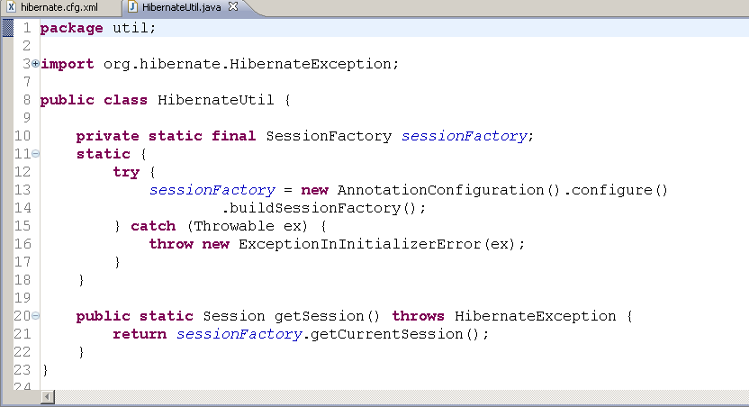
Example: Load the configuration

Slide 16
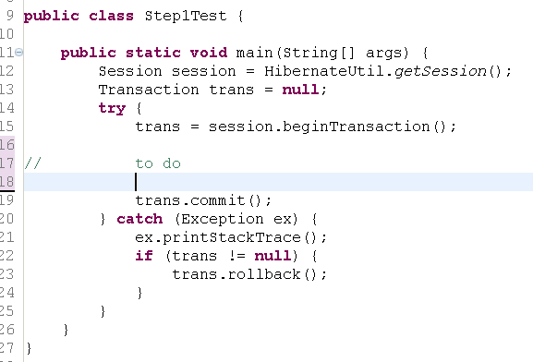
Example: Database Interaction

Slide 17
Example
public class Employee {
private int id;
private String first_name;
private String last_name;
private int salary;
public Employee() {}
public Employee(String fname, String lname, int salary) {
this.first_name = fname;
this.last_name = lname;
this.salary = salary;
}
public int getId() {
return id;
}
public String getFirstName() {
return first_name;
}
public String getLastName() {
return last_name;
}
public int getSalary() {
return salary;
}
}

Slide 18
Annotated Class Example
Consider we are going to use following EMPLOYEE table to store our objects:
create table EMPLOYEE (
id INT NOT NULL auto_increment,
first_name VARCHAR(20) default NULL,
last_name VARCHAR(20) default NULL,
salary INT default NULL,
PRIMARY KEY (id)
);

Slide 19
Annotated Class Example
import javax.persistence.*;
@Entity
@Table(name = "EMPLOYEE")
public class Employee {
@Id @GeneratedValue
@Column(name = "id")
private int id;
@Column(name = "first_name")
private String firstName;
@Column(name = "last_name")
private String lastName;
@Column(name = "salary")
private int salary;
public Employee() {}
public int getId() {
return id;
}
public void setId( int id ) {
this.id = id;
}
. . . .

Slide 20
Create Application Class
import org.hibernate.*;
import org.hibernate.cfg.*;
public class ManageEmployee {
private static SessionFactory factory;
public static void main(String[] args) {
try{
factory = new AnnotationConfiguration().
configure().
addAnnotatedClass(Employee.class).
buildSessionFactory();
}catch (Throwable ex) {
System.err.println("Failed to create sessionFactory" + ex);
throw new ExceptionInInitializerError(ex);
}
ManageEmployee ME = new ManageEmployee();

Slide 21
Data operations
/* Add few employee records in database */
Integer empID1 = ME.addEmployee("Zara", "Ali", 1000);
Integer empID2 = ME.addEmployee("Daisy", "Das", 5000);
Integer empID3 = ME.addEmployee("John", "Paul", 10000);
/* List down all the employees */
ME.listEmployees();
/* Update employee's records */
ME.updateEmployee(empID1, 5000);
/* Delete an employee from the database */
ME.deleteEmployee(empID2);
/* List down new list of the employees */
ME.listEmployees();
}

Slide 22
Method to CREATE an employee
public Integer addEmployee(String fname, String lname, int salary){
Session session = factory.openSession();
Transaction tx = null;
Integer employeeID = null;
try{
tx = session.beginTransaction();
Employee employee = new Employee();
employee.setFirstName(fname);
employee.setLastName(lname);
employee.setSalary(salary);
employeeID = (Integer) session.save(employee);
tx.commit();
}catch (HibernateException e) {
if (tx!=null) tx.rollback();
e.printStackTrace();
}finally {
session.close();
}
return employeeID;
}

Slide 23
Method to READ all the employees
public void listEmployees( ){
Session session = factory.openSession();
Transaction tx = null;
try{
tx = session.beginTransaction();
List employees = session.createQuery("FROM Employee").list();
for (Iterator iterator =
employees.iterator(); iterator.hasNext();){
Employee employee = (Employee) iterator.next();
System.out.print("First Name: " + employee.getFirstName());
System.out.print(" Last Name: " + employee.getLastName());
System.out.println(" Salary: " + employee.getSalary());
}
tx.commit();
}catch (HibernateException e) {
if (tx!=null) tx.rollback();
e.printStackTrace();
}finally {
session.close();
}
}

Slide 24
Method to UPDATE salary for an employee
public void updateEmployee(Integer EmployeeID, int salary ){
Session session = factory.openSession();
Transaction tx = null;
try{
tx = session.beginTransaction();
Employee employee =
(Employee)session.get(Employee.class, EmployeeID);
employee.setSalary( salary );
session.update(employee);
tx.commit();
}catch (HibernateException e) {
if (tx!=null) tx.rollback();
e.printStackTrace();
}finally {
session.close();
}
}

Slide 25
Method to DELETE an employee
public void deleteEmployee(Integer EmployeeID){
Session session = factory.openSession();
Transaction tx = null;
try{
tx = session.beginTransaction();
Employee employee =
(Employee)session.get(Employee.class, EmployeeID);
session.delete(employee);
tx.commit();
}catch (HibernateException e) {
if (tx!=null) tx.rollback();
e.printStackTrace();
}finally {
session.close();
}
}
}

Slide 26
Database Configuration hibernate.cfg.xml
<?xml version="1.0" encoding="utf-8"?>
<!DOCTYPE hibernate-configuration SYSTEM
"http://www.hibernate.org/dtd/hibernate-configuration-3.0.dtd">
<hibernate-configuration>
<session-factory>
<property name="hibernate.dialect">
org.hibernate.dialect.MySQLDialect
</property>
<property name="hibernate.connection.driver_class">
com.mysql.jdbc.Driver
</property>
<!-- Assume students is the database name -->
<property name="hibernate.connection.url">
jdbc:mysql://localhost/test
</property>
<property name="hibernate.connection.username">
root
</property>
<property name="hibernate.connection.password">
cohondob
</property>
</session-factory>
</hibernate-configuration>

Slide 27
Requirements on the Entity Class

Slide 28
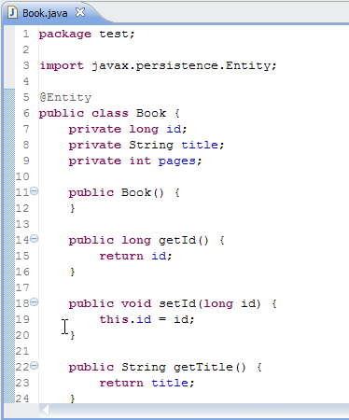
Requirements on the Entity Class
Book
id : Long
title : String
pages : Integer
The entity class must be annotated with the @Entity annotation
No-arg constructor
Getters/setters of all attributes

Slide 29
Primary Keys and Entity Identity
Every entity must have a primary key.
A simple (i.e., non-composite) primary key must correspond to a single persistent ﬁeld or property of the entity class.The @Id annotation speciﬁes the primary key property or ﬁeld of an entity.
The primary key should be one of the following types: any Java primitive type; any primitive wrapper type; java.lang.String; java.util.Date; ….

Slide 30
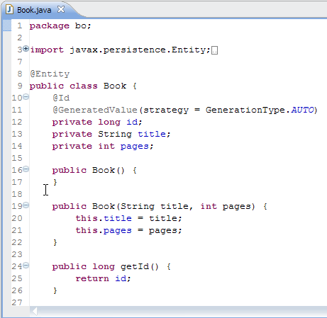
Primary Keys and Entity Identity
The @GeneratedValue annotation provides for the speciﬁcation of generation strategies for the values of primary keys.
The AUTO value indicates that the persistence provider should pick an appropriate strategy for the particular database
GenerationType enum: TABLE, SEQUENCE, IDENTITY, AUTO

Slide 31

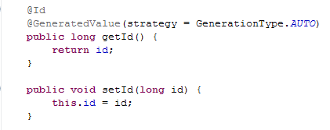
Persistent Fields and Properties
If the entity has ﬁeld-based access: All instance variables that are not annotated with the @Transient annotation are persistent.
If the entity has property-based access: All properties not annotated with the @Transient annotation are persistent.
Có thể đánh dấu trên thuộc tính hoặc method

Slide 32
Entity Relationships
OneToOne
OneToMany
ManyToOne
ManyToMany

Slide 33
Entity Relationships
Relationships may be bidirectional or unidirectional.
A bidirectional relationship has both an owning side and an inverse side.
A unidirectional relationship has only an owning side.
The owning side of a relationship determines the updates to the relationship in the database.
The inverse side of a bidirectional relationship must refer to its owning side by use of the mappedBy element of the OneToOne, OneToMany,or ManyToMany annotation

Slide 34

ManyToOne (owning side)
Bidirectional ManyToOne / OneToMany Relationships
Entity A references a single instance of Entity B.
Entity B references a collection of Entity A.
Entity A must be the owner of the relationship.
Book
Publisher
*
id : Long
id : Integer
*
title : String
name : String
1
1
pages : Integer

Slide 35
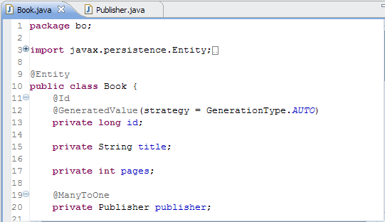
ManyToOne (owning side)

Slide 36
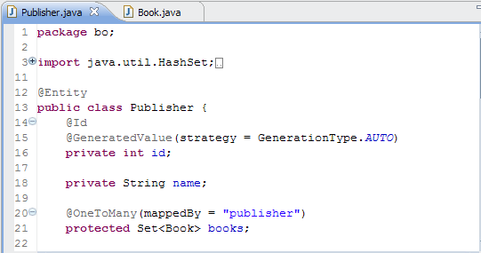
ManyToOne (inverse side)
ManyToOne (inverse side) -> OneToMany using mappedBy

Slide 37
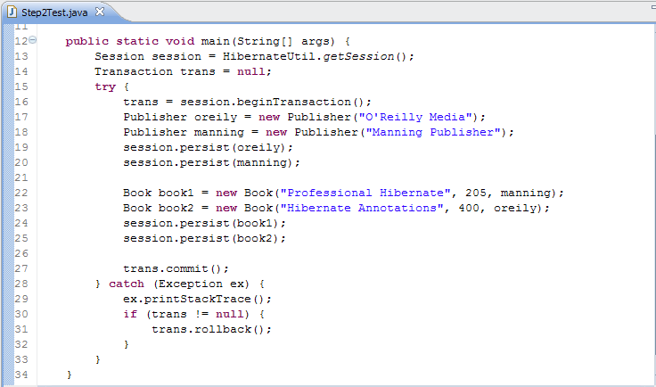


ManyToOne: Result

Slide 38
ManyToMany
Bidirectional ManyToMany Relationships
Entity A references a collection of Entity B.
Entity B references a collection of Entity A.
Entity A is the owner of the relationship.

Slide 39
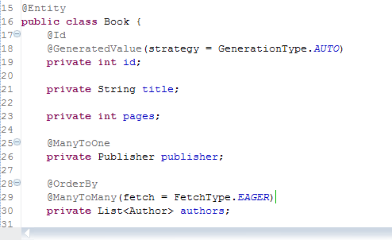
ManyToMany (owning side)

Slide 40
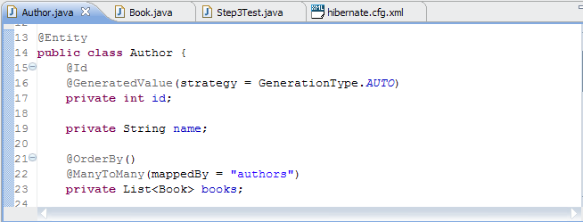
ManyToMany (inverse side)
ManyToMany (inverse side) -> ManyToMany using mappedBy

Slide 41
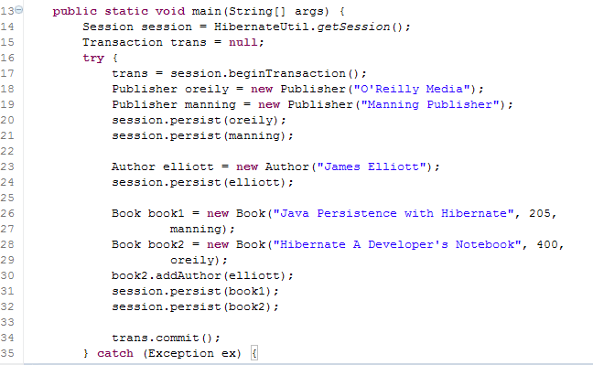




ManyToMany: Result

Slide 42
OneToOne
Bidirectional OneToOne Relationships
Entity A references a single instance of Entity B.
Entity B references a single instance of Entity A.
Entity A is speciﬁed as the owner of the relationship.

Slide 43
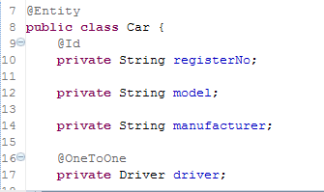
OneToOne (owning side)

Slide 44
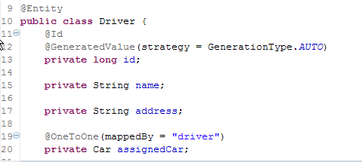
OneToOne (inverse side)
OneToOne (inverse side) -> OneToOne using mappedBy

Slide 45
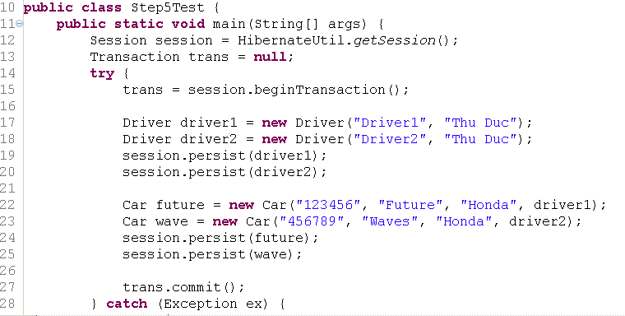


OneToOne: Result

Slide 46
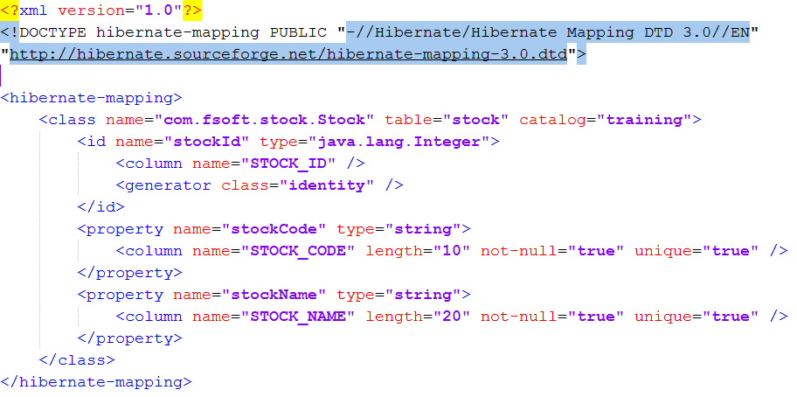
Basic O/R Mapping - XML file
File : Stock.hbm.xml
Notes:
Create the model class and mapping files are quite tedious in large application
With Hibernate tools, this can be generate automatically

Slide 47
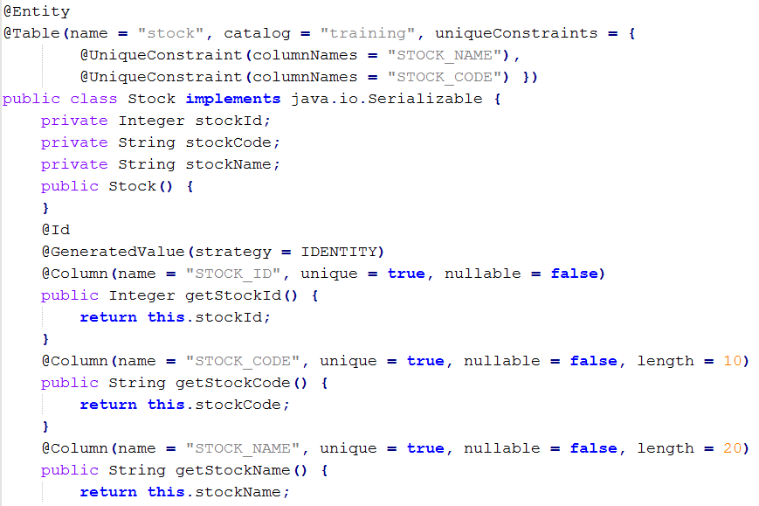
Basic O/R Mapping - Annotations
Notes:
@Entity annotation marks this class as an entity bean
@Table annotation allows you to specify the details of the table that will be used to persist the entity in the database
@Column annotation is used to specify the details of the column to which a field or property will be mapped.

Slide 48
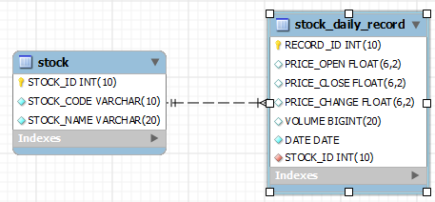
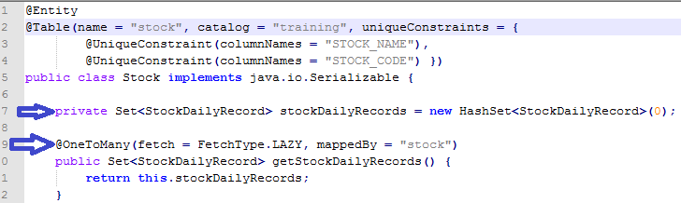
Association & Collection Mapping – One to Many
Notes:
@Entity annotation marks this class as an entity bean
@Table annotation allows you to specify the details of the table that will be used to persist the entity in the database
@Column annotation is used to specify the details of the column to which a field or property will be mapped.

Slide 49
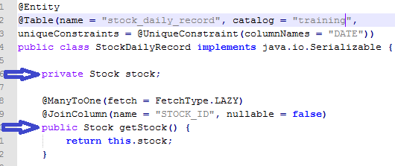
Association & Collection Mapping – One to Many
Notes:
@Entity annotation marks this class as an entity bean
@Table annotation allows you to specify the details of the table that will be used to persist the entity in the database
@Column annotation is used to specify the details of the column to which a field or property will be mapped.

Slide 50
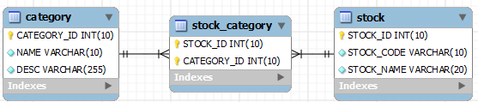
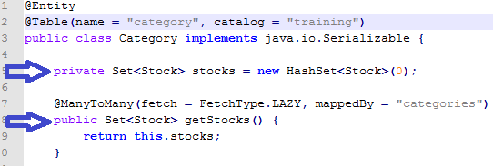
Association & Collection Mapping – Many to Many

Slide 51
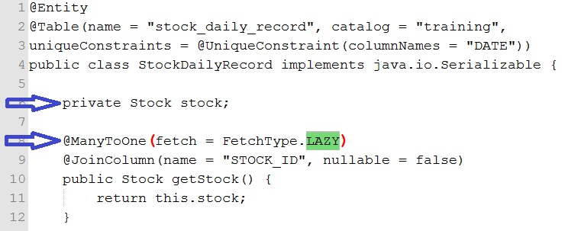
Working with lazy associations
Does not actually load all the children when loading the parent.
Load children when requested to do it
Lazy loading can help improve the performance

Slide 52
Hibernate Configuration
Hibernate configuration is managed by an instance of org.hibernate.cfg.Configuration
Hibernate provides following types of configurations
hibernate.properties
hibernate.cfg.xml
Programatic configuration (API-based)

Slide 53
Hibernate Configuration - hibernate.properties
A Java compliant property file which holds key value pair for different hibernate configuration strings
hibernate.connection.driver_class=com.mysql.jdbc.Driver
hibernate.connection.url= jdbc:mysql://localhost:3306/training
hibernate.connection.username=root
hibernate.connection.password=password
hibernate.connection.pool_size=1

Slide 54
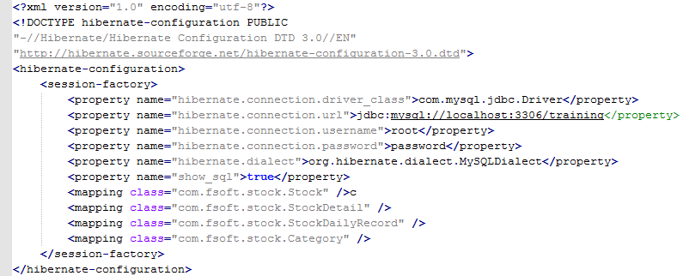
Hibernate Configuration - hibernate.cfg.xml
Notes:
Contains all the configuration parameters like database connection, class mappings

Slide 55
Hibernate Configuration - hibernate.cfg.xml
All configurations in hibernate.cfg.xml will be loaded by using following API
SessionFactory sf = new Configuration().configure(). buildSessionFactory();
You can select a different XML configuration file using:
SessionFactory sf = new Configuration(). configure(“cust.cfg.xml").buildSessionFactory();
Notes:
Both hibernate.cfg.xml and hibernate.properties files can be provided simultaneously in an application. In this case hibernate.cfg.xml gets precedence over hibernate.properties.

Slide 56


Hibernate Configuration - Programmatic
Instantiate Configuration directly and specify XML mapping document
Specify the mapped class

Slide 57
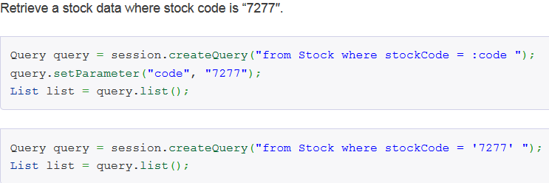
Hibernate Query Language (HQL)
Syntax is quite similar to database SQL language
Uses class name instead of table name, and property names instead of column name

Slide 58
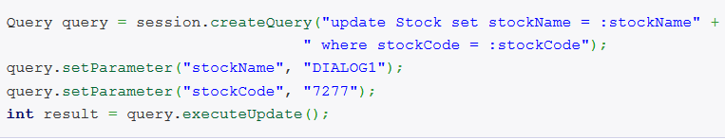
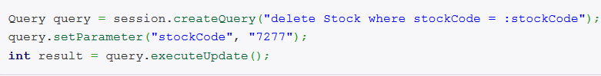
HQL- Example
Update a stock name to “DIALOG1″ where stock code is “7277″
Delete a stock where stock code is “7277″

Slide 59
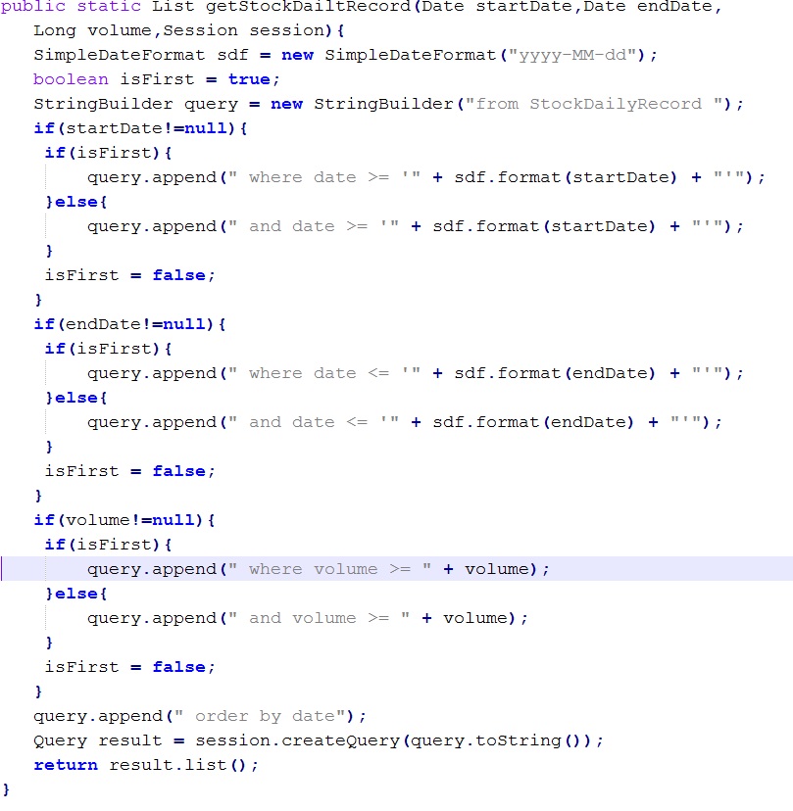
Criteria Queries
Notes:
Here’s a case study to retrieve a list of StockDailyRecord, with optional search criteria – start date, end date and volume, order by date.

Slide 60
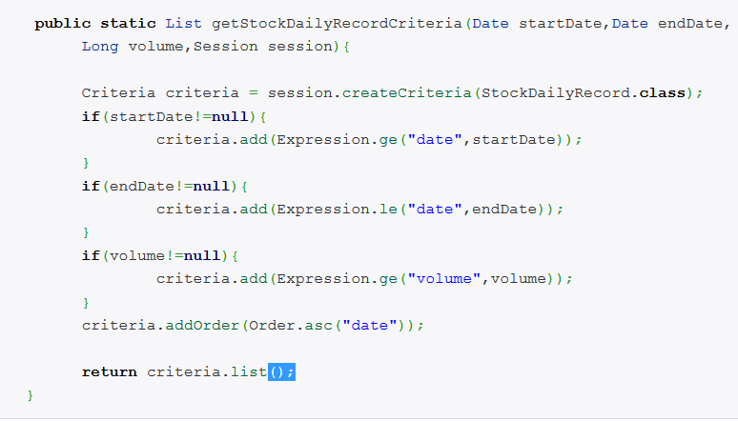
Criteria Queries
Notes:
Java-based for API for building queries
Good for queries that are built up using lots of conditional logic; avoid messy string manipulation
This is Criteria example, you do not need to compare whether this is the first criteria to append the ‘where’ syntax, nor format the date. The line of code is reduce and everything is handled in a more elegant and object oriented way.

Slide 61
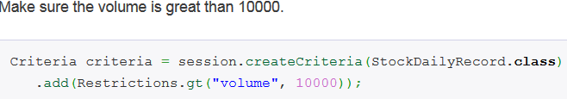
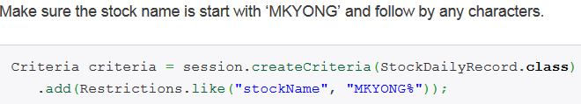
Criteria Queries
Restrictions.eq, lt, le, gt, ge
Restrictions.like, between, isNull, isNotNull

Slide 62
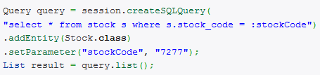
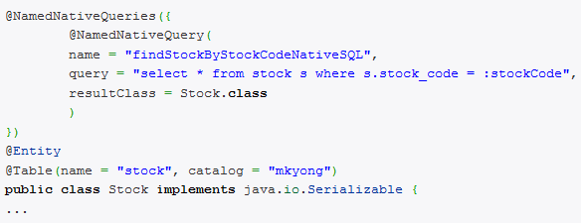
Native SQL
Native SQL
Name SQL query
Notes:
Hibernate provide a createSQLQuery method to let you call your native SQL statement directly.

Slide 63
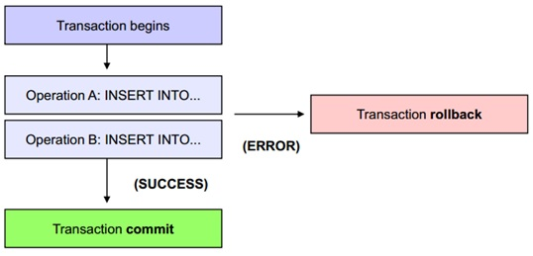
Transactions
A set of database operations which must be executed in entirely or not at all
Should and either with a commit or a rollback
All communication with a database has to occur inside a transaction

Slide 64
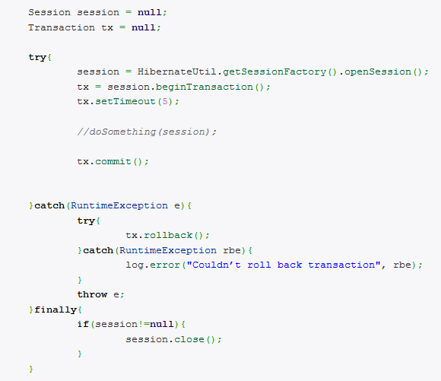
Transaction Handle
Notes:
Any exceptions thrown by Hibernate are FATAL, you have to roll back the transaction and close the current session immediately

Slide 65
Building Hibernate Application
Maven 3 + Hibernate 3 + MySQL 5.5 + JDK 1.6
POM: Add Hibernate and MySQL dependency
MySQL Script: Create table in MySQL
Create the domain model with annotation
Create Hibernate configuration file hibernate.cfg.xml
Implement a HibernateUtil class
Write main class

Slide 66
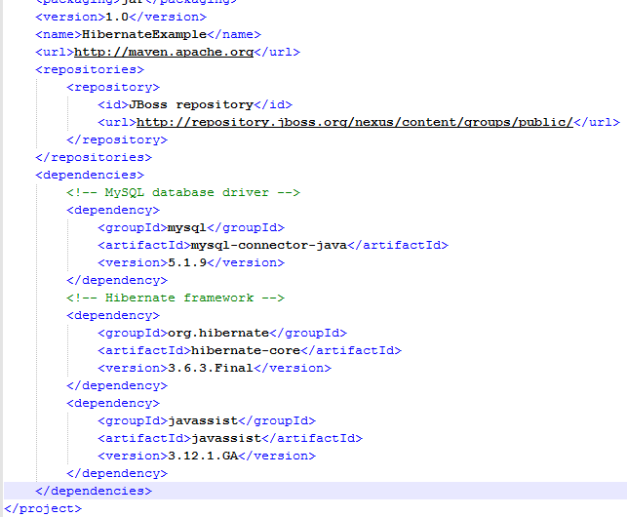
Add Hibernate and MySQL dependency

Slide 67
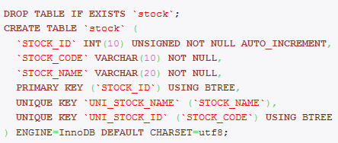
Create table
Notes:
MySQL script to create a “stock” table

Slide 68
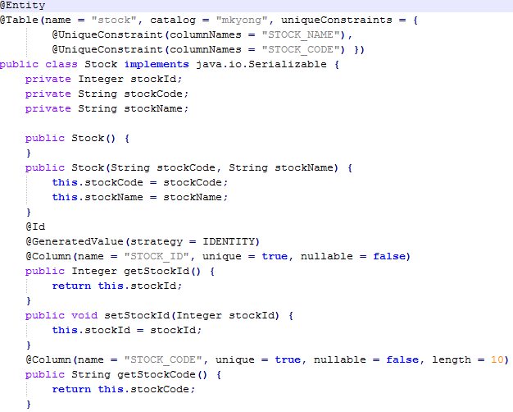
Create the domain model with annotation

Slide 69
Create Hibernate Configuration file
Notes:
Make Hibernate aware of the mapping classes : Stock

Slide 70
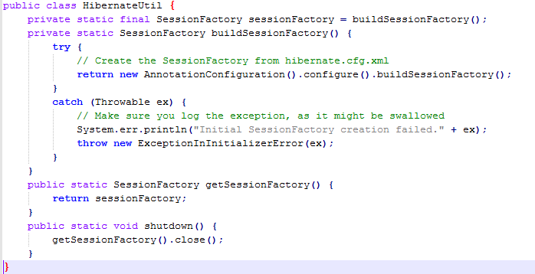
Create Hibernate Utility class
Notes:
Convenience class to handle building and obtaining the Hibernate SessionFactory
– Use recommended by the Hibernate org
Used to build Hibernate ‘Sessions’

Slide 71
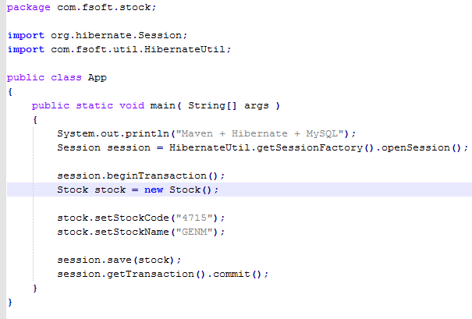
Main class
Notes:
Run your App.java, it will insert a new record into “Stock” table.
Hibernate: insert into mkyong.stock (STOCK_CODE, STOCK_NAME) values (?, ?)

